Slide 1
Developing Integration Solutions using Microsoft BizTalk Server 2013
Introduction to Orchestrations

Slide 2

Course Outline
Module 1: Introduction to BizTalk Server
Module 2: Schemas
Module 3: Maps
Module 4: Testing and Deploying BizTalk projects
Module 5: Pipelines
Module 6: Routing
Module 7: Adapters
Module 8: Web Services and WCF
Module 9: Introduction to Orchestrations
Lesson 1: Building an Orchestration
Lesson 2: The Orchestration Engine
Lesson 3: Monitoring Orchestrations
Module 10: Applied Orchestration Techniques
Module 11: Business Activity Monitoring
Module 12: Integrating Business Rules
Module 13: Deploying and Managing Applications
Module 14: Windows Azure BizTalk Services

Slide 3
Lesson 1: building Orchestrations
Modeling a Business Process
What is an Orchestration?
Building Orchestrations
Demonstration: Creating Orchestrations
Deploying and Testing Orchestrations
Demonstration: Deploy and Test Orchestrations

Slide 4
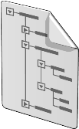
Modeling a Business Process
BizTalk
CRM
Order Service
OLF
New Order
Send For Approval
Complement Order
Submit Order

Slide 5
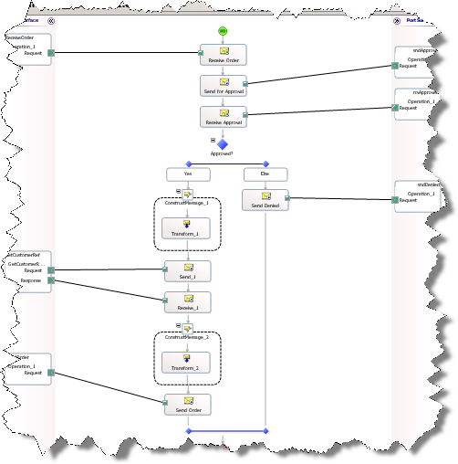
What is an Orchestration?
Orchestrations
Represents an executable business process
Based on a c# like language, XLANG/s
Subscribes to and publishes messages
Can construct new messages

Slide 6
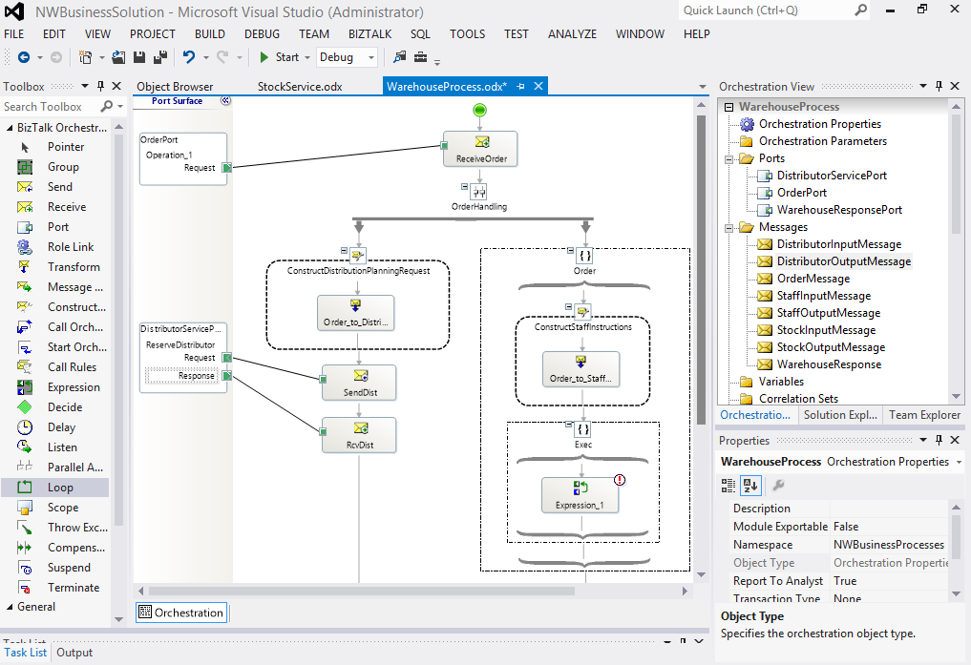
Orchestration Designer
Visual Designer
Pre-defined shapes
Drag-drop-configure
Not extensible, but the Expression shape allows you to do basically anything.
Design Surface
Orchestration view
Toolbox
Port Surface
Property Window

Slide 7
Orchestration shapes
Category | Shapes
Message and data handling | Receive, Send, Construct, Assign, Transform
Containers | Scope, Group
Flow control | Decide, Delay, Listen, Loop, Parallell, Suspend, Terminate, Throw Exception
Nesting Orchestrations | Call Orchestration, Start Orchestration
Other | Expression

Slide 8




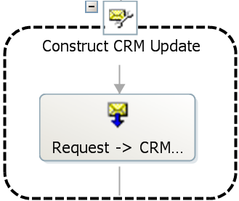
Orchestration Shapes
Message and data handling shapes
Receive | Receive a message.
Send | Send a message.
Construct | Construct a message.
Assign | Assign message values or entire message.
Transform | Map fields between messages.
Hint!
Some shapes must be nested within others.

Slide 9






Orchestration Shapes
Flow control shapes
Decide | Do conditional branching (if, if.., else).
Delay | Wait based on a time-out interval.
Listen | Branch based on a message being received or a time-out period expiring.
Loop | Loop while or until a condition is met
Parallell | Perform two or more independent actions.
Suspend | Place the orchestration in a suspended state to allow administrative intervention.
Terminate | End the orchestration.
Throw Exception | Explicitly throw an exception.

Slide 10






Orchestration Shapes
Container shapes
Scope | Enables transactional behavior and exception handling.
Group | Visual grouping of shapes for easier overview.
Nesting Orchestrations
Call Orchestration | Enables you to synchronously call another orchestration with input and output parameters.
Start Orchestration | Asynchronous “fire and forget” start another orchestration.
Other
Expression | Perform XLANG/s statements or call .NET components.
Call Rules | Call a Business Rules Policy.
Compensation | Enables you apply compensation logic after a failure has occurred.

Slide 11
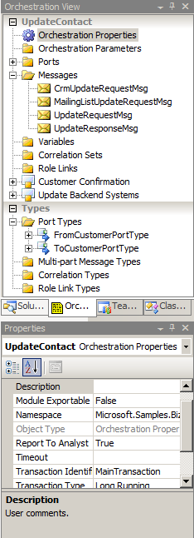
Orchestration View
Orchestration View
Allows tree view structured design and configuration access to for example types, messages, variables and correlations.
Message variables
Messages represent input and output
Messages are immutable
Messages match a MessageType
Messages can alternatively be of type XmlDocument

Slide 12
Ports
Communication pattern
Communication direction
One-Way
Request-Response
Receive
Send

Slide 13
Ports
Binding style
Logical vs. physical ports
Specify Now
Specify Later
Direct
Filter
Self-correlating
Partner orchestration
Dynamic (send only)
Physical ports (receive and send ports) are connected to orchestrations through binding.
Binding sets up a subscription between the orchestration and the port.

Slide 14

Demonstration: Creating Orchestrations
Adding basic shapes
Working with decisions
Working with messages
Working with transformations
Notes:
(Slide 14) Scenario: Get a customer, lookup an adress, map them to one document If adress is sweden, send local, else send international
Open C:\Demos\Mod9\Start\Mod9\Mod9.sln
Add New Item – Orchestration – CustomerProcess.odx
Add two receive shapes, a transform, a decision, and one send per rule.
Create messages
Position messages on send shapes
Create the map
Create ports

Slide 15
Steps to go through to build, configure and start an orchestration
1
2
3
Add shapes to represent the business process
Add schemas to describe message formats
Define ports through which messages are received and sent
8
Start and test the orchestration
4
Connect receive and send shapes to ports
5
Transform and otherwise process the messages to complete the business process
6
Build the orchestration
7
Deploy and bind the orchestration

Slide 16
Orchestration states
Start
Unenlisted (unbound)
Enlist
Start
Unenlisted / Bound
Stopped
Started
Setup Bindings
Unenlist
Stop
Unenlist

Slide 17




Binding Orchestrations
Orchestration
Logical Receive Port
Logical Send Port
Direct
Bind
Bind
Message Box
Physical Receive Port
Physical Send Port

Slide 18
Demonstration: Testing Orchestrations
Build, deploy, bind, start and test an orchestration

Slide 19
Lesson 2: The Orchestration ENGINE
Introduction to the Orchestration Engine
Understanding Persistence
Service Instance States

Slide 20
What is the Orchestration Engine?
Functions of the Orchestration engine
Create orchestration instances
Handle persistence
Host .NET components
Transactions
Resource optimization
Load throttling
Runtime validation

Slide 21

Persistence
Persistence
Saves the entire state of the orchestration to the database.
Provides reliable recovery and resource optimization.
Persistence is expensive!
You can sometimes control when persistence occurs!
Dehydrate
Persistence points
End of transactional scope
At debugging breakpoints
At Start Orchestration and Send shapes
When the orchestration is suspended
On controlled shutdown of BizTalk
When the orchestration finishes
When the engine determines it appropriate
Rehydrate
MsgBox

Slide 22
Lesson 3: Monitoring Orchestrations
The Group Hub
The Orchestration Debugger

Slide 23
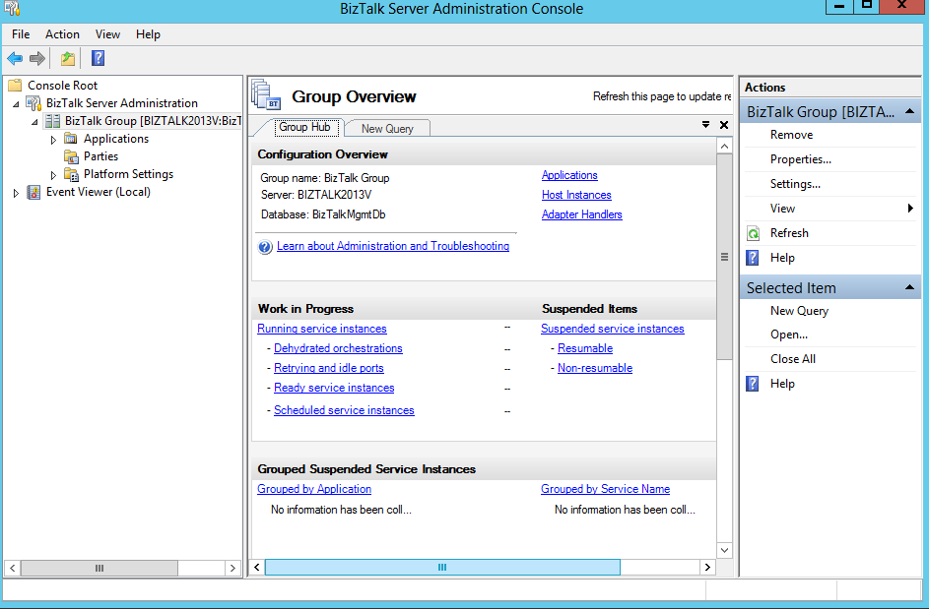
Administration Console and Group Hub
Configuration and Management
Configure binding and tracking for orchestrations
Alter state of orchestrations
Monitor and track orchestrations instances
MMC Console

Slide 24
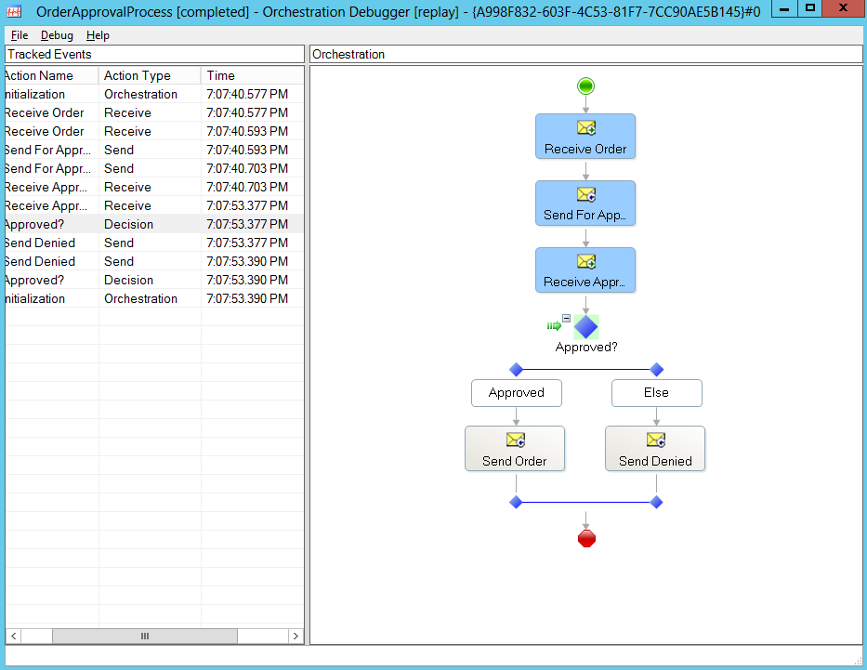
Orchestration Debugger
Debugging
View orchestration instances and messages
Set breakpoints
Suspend, terminate, or resume processes
View variables and data
Orchestration Debugger

Slide 25
Orchestration Service Instance States
Service Instance States
State | Explanation
In Breakpoint | Orchestration has hit a breakpoint set in the Orchestration Debugger.
Ready to run | An activated instance that has not yet started running, normally due to throttling or unavailability of resources.
Active | Executing service instance.
Dehydrated | Persisted in the database waiting to be activated.
Pending suspend/Pending terminate | A control message has been submitted but not yet picked up by the instance.
Suspended (resumable) | Suspended, can be resumed.
Suspended (not-resumable) | Suspended, can not be resumed.
Completed with discarded messages | Instance completed without consuming all of it’s messages, leaving ”Zombies” behind.

Slide 26
Demonstration: Monitoring Orchestrations
Monitoring Orchestrations

Slide 27
Summary
Orchestrations are a way to implement workflows, or business processes.
Persistence is when BizTalk serializes all in-memory data to the database, to improve performance and fault tolerance.
Once deployed, orchestrations has to bound to create subscriptions, and stopped or started for those subscriptions to be active.

Slide 28
Q & A
Introduction to Orchestrations

Slide 29

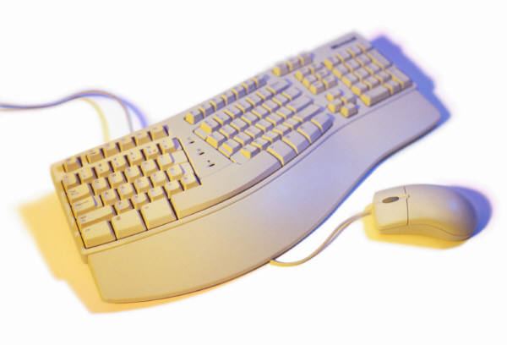
Hands-On-Labs
Creating BizTalk Server Orchestrations
Creating Orchestrations
Binding logical ports to physical ports
Working with correlation
Creating messages
Manipulate context properties and working with distinguished fields.

Slide 30

Quiz
When would you use the parallell shape?
What happens to messages headed for an orchestration that is in the Stopped state?
How would you go about calling a custom component from an orchestration?

